Slide 1

C++ & DSA PLACEMENT COURSE
Khaiser Khanam

Slide 2

LEETCODE

Slide 3
What is LeetCode?
Understand Platform
How will LeetCode Help
How many Questions need to be solved?
LeetCode Contests
LeetCode Question Types
Is LeetCode Premium worth?
Will LeetCode will help in Job Referrals?
Use LeetCode Like a Pro
LeetCode Alternatives
Tips

Slide 4

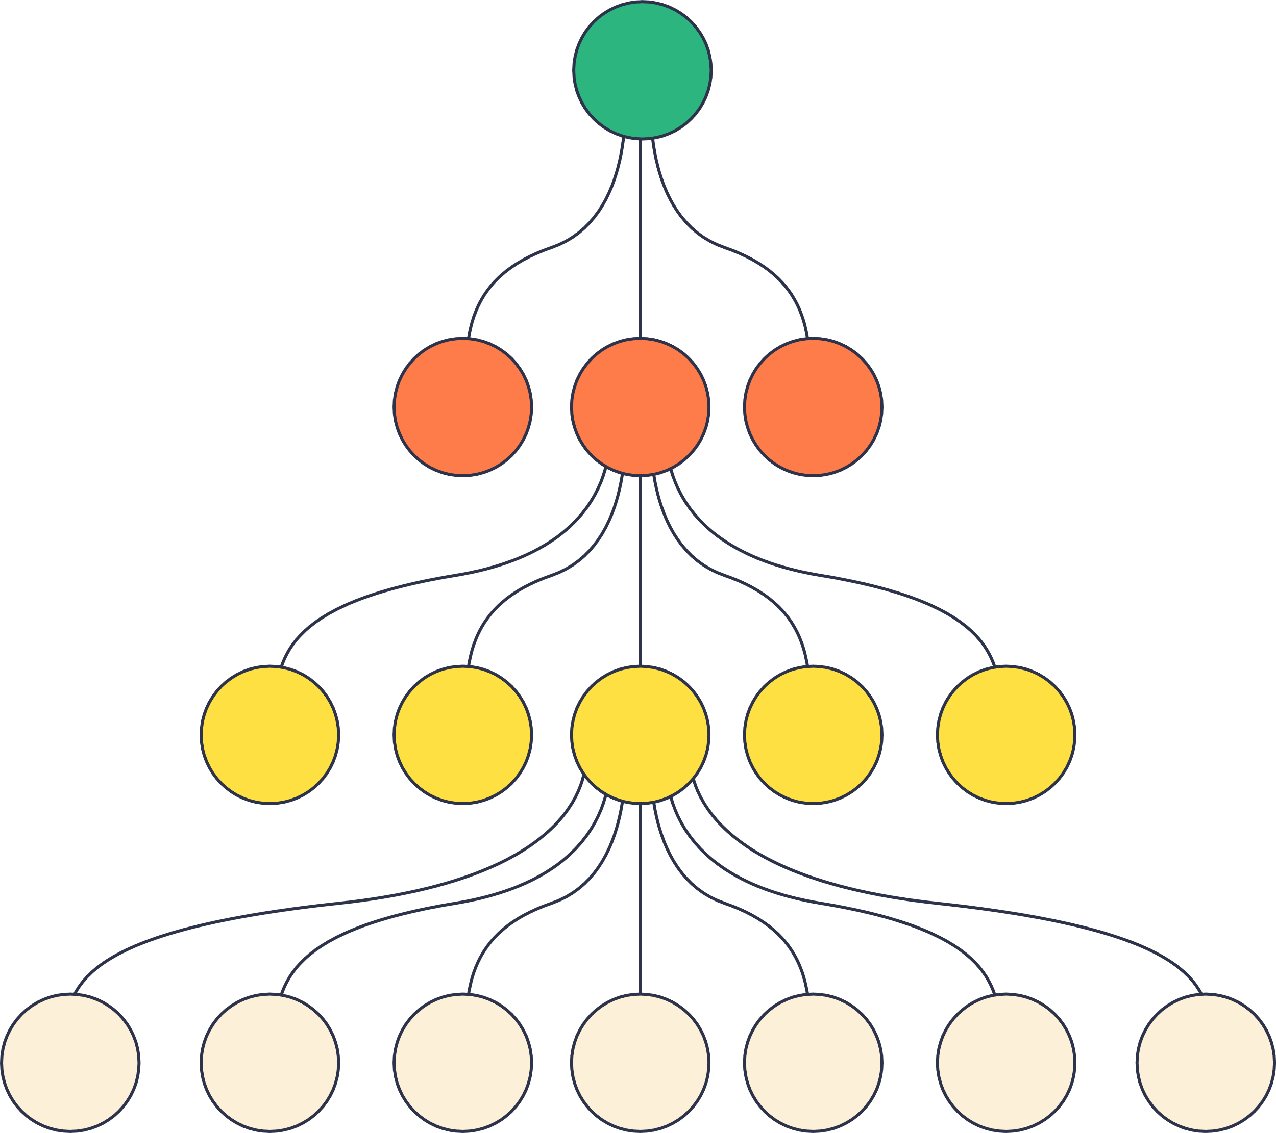


Data Structures
Algorithms
Competitive Programming
Interview Preparation

Slide 5
LeetCode Contests
1. Weekly Contest (every Sunday at 8:00 AM IST (Indian Standard Time)
2. Biweekly Contest (Every 2nd Sunday)
3. Monthly Challenges
4. Daily coding challenge

Slide 6
Hi, I’m preparing for SDE roles. Here’s my LeetCode profile – I’ve solved 400+ problems and regularly rank top 10% in contests.

Slide 7
How to Use LeetCode Like a Pro
Step 1: Pick a topic (e.g., Arrays)
Step 2: Dry Run karo, brute force likho, phir optimal socho
Step 3: Contest har week do
Step 4: Maintain a digital notebook
Step 5: Maintain Profile

Slide 8
Leetcode Alternatives
1.CodeStudio (by Coding Ninjas) – Guided Paths
2.GFG (GeeksforGeeks) – Theory + Questions
3.HackerRank – Government/Company hiring challenges
4.Codeforces – Competitive programming
5.AtCoder, CSES – Pure DSA
6.InterviewBit – Structured interview prep

Slide 9
Tips
Tag-wise practice karo (Array, Stack, DP, etc.)
Daily solve atleast 2 questions –easy ya medium ya hard
Notebook ya OneNote pe solutions likho
Dry run
Explanations and Refer Discussions
Notes banao – edge cases, tricks, patterns

